Slide 1


Consumer Goods
Ad_Hoc Insights

Slide 2
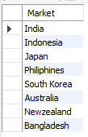
Atliq Exclusive Markets in APAC Region
Question
Provide the list of markets in which customer "Atliq Exclusive"
operates its business in the APAC region.
Output

Slide 3

Unique Products
Question
What is the percentage of unique product increase in 2021 vs. 2020? The final output contains
these fields,
unique_products_2020
unique_products_2021
percentage_chg
Output

Slide 4
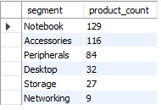
Segment Wise Unique Products - 1
Question
Provide a report with all the unique product counts for each segment and sort them
in descending order of product counts. The final output contains 2 fields,
segment
product_count
Output

Slide 5
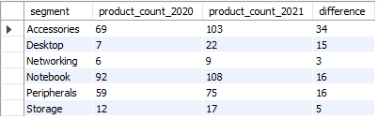
Segment Wise Unique Products - 2
Question
Follow-up: Which segment had the most increase in unique products in
2021 vs 2020? The final output contains these fields,
segment
product_count_2020
product_count_2021
difference
Output

Slide 6

Manufacturing Costs
Question
Get the products that have the highest and lowest manufacturing costs.
The final output should contain these fields,
product_code
product manufacturing_cost
Output

Slide 7
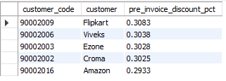
Pre-invoice Discount
Question
Generate a report which contains the top 5 customers who received an
average high pre_invoice_discount_pct for the fiscal year 2021 and in the
Indian market. The final output contains these fields,
customer_code
customer
average_discount_percentage
Output

Slide 8
Gross Sales Report – Atliq Exclusive
Question
Get the complete report of the Gross sales amount for the customer “Atliq Exclusive”
for each month. This analysis helps to get an idea of low and high-performing months
and take strategic decisions. The final report contains these columns:
Month
Year
Gross sales Amount
Output
November is the best performing month,
April has the lowest performance

Slide 9
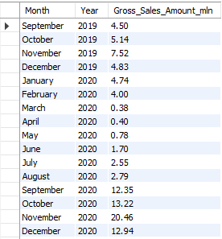
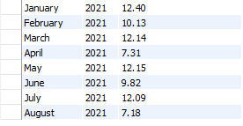
Gross Sales Report – Atliq Exclusive
Month | Year | Gross Sales Amt.(Millions)
September | 2019 | 4.5
October | 2019 | 5.14
November | 2019 | 7.52
December | 2019 | 4.83
January | 2020 | 4.74
February | 2020 | 4
March | 2020 | 0.38
April | 2020 | 0.4
May | 2020 | 0.78
June | 2020 | 1.7
July | 2020 | 2.55
August | 2020 | 2.79
September | 2020 | 12.35
October | 2020 | 13.22
November | 2020 | 20.46
December | 2020 | 12.94
January | 2021 | 12.4
February | 2021 | 10.13
March | 2021 | 12.14
April | 2021 | 7.31
May | 2021 | 12.15
June | 2021 | 9.82
July | 2021 | 12.09
August | 2021 | 7.18

Slide 10

Quarter-wise Sales Report - 2020
Question
In which quarter of 2020, got the maximum total_sold_quantity?
The final output contains these fields sorted by the total_sold_quantity,
Quarter
total_sold_quantity
Output
Q1 of 2020 has the maximum
sold quantity

Slide 11

Channel-wise Gross Sales - 2021
Question
Which channel helped to bring more gross sales in the fiscal year 2021 and
the percentage of contribution?
The final output contains these fields,
channel
gross_sales_mln
percentage
Output
Retailer has the highest gross
sales of 1219 millions dollars
in 2021 which is 73% of the
Total sales in the same year.

Slide 12
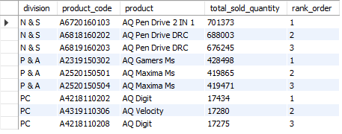
Division-wise Top 3 Products - 2021
Question
Get the Top 3 products in each division that have a high total_sold_quantity
in the fiscal_year 2021? The final output contains these fields
division
product_code
product
total_sold_quantity
rank_order
Output

Slide 13
Division-wise Top 3 Products - 2021

Slide 14
Thank You
By
Amit Vikram Raj
LinkedIn

